Slide 1

ASP.NET Core Web App with User Data Protected by Authorization
Group 5

Slide 2
Group Members
Ifeoluwa afe 200596002
Olajumoke akpausoh 200605467

Slide 3

Project Summary
The task involves creating an ASP.NET Core Web Application with strong user data protection mechanisms. Emphasis is placed on implementing user authorization to secure access to sensitive information and functionalities.

Slide 4

Project Setup
Created a New ASP.NET Core Web Application utilizing Visual Studio
Configured the Essential NuGet Packages for authentication and authorization, such as Microsoft.AspNetCore.Authentication.JwtBearer for token-based authentication, Microsoft.AspNetCore.Identity.EntityFrameworkCore for user management, Microsoft.EntityFrameworkCore.SqlServer for interacting with Microsoft SQL Server databases and Microsoft.EntityFrameworkCore.Tools for managing various aspects of EF Core, including migrations, database updates, and model generation
Set up the SQL Server and configure the application to connect to the SQL Server database using a connection string defined in appsettings.json
Configured Entity Framework Core by utilizing Microsoft.EntityFrameworkCore to manage data access
set up a DbContext to interact with the SQL Server database

Slide 5

Project Setup
Utilize ASP.NET Core Identity to handle user registration, login, and password management securely
Created policies that specify the access requirements for different parts of the application based on user roles
Applied the control policies using the [Authorize] attributes on the controllers
Used EF Core migrations to create and update the database schema based on the data models.
Tested the authentication process to ensure users can access their accounts and validated that the authorization policies are enforced correctly.

Slide 6
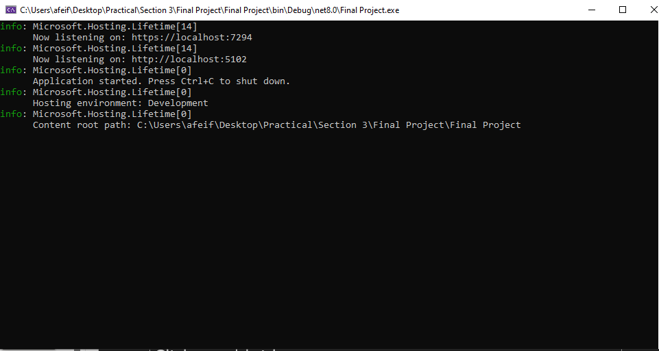
Output 1

Slide 7
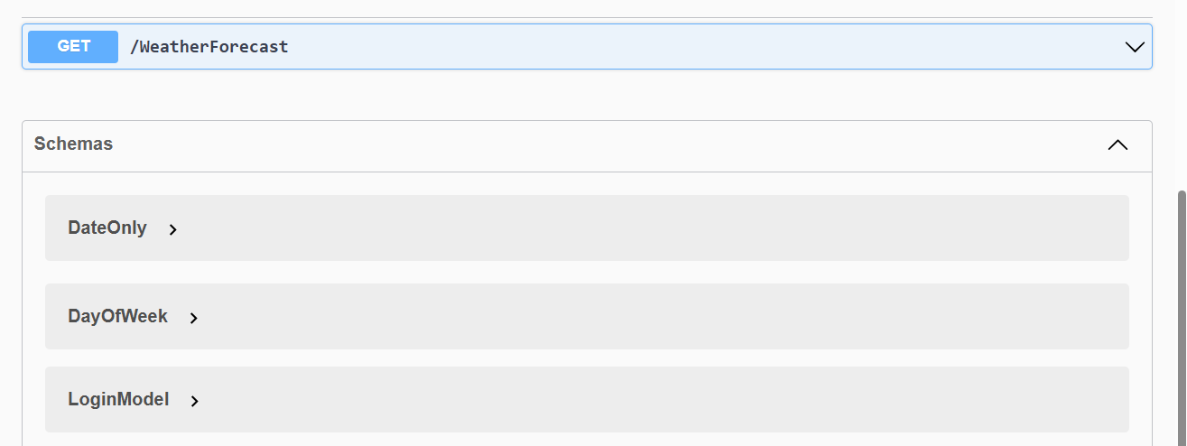
Output 2

Slide 8
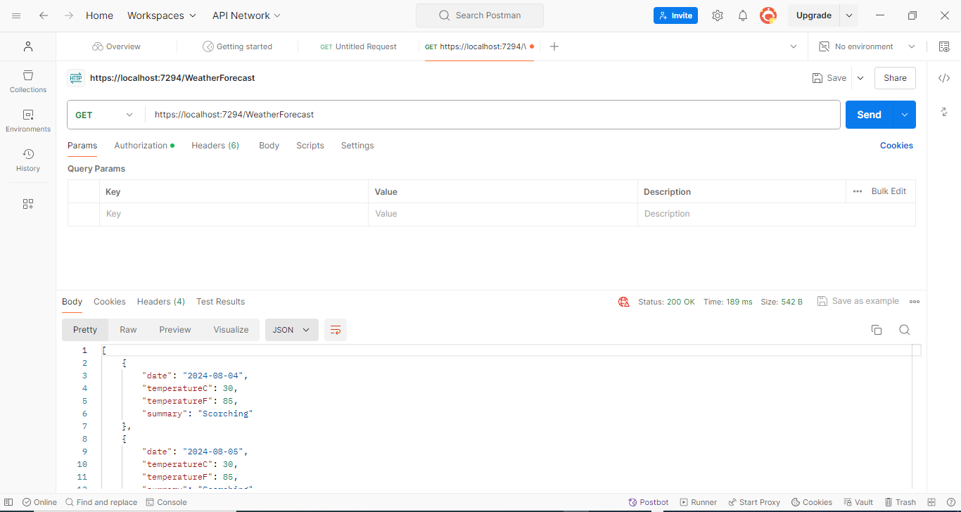

Slide 9
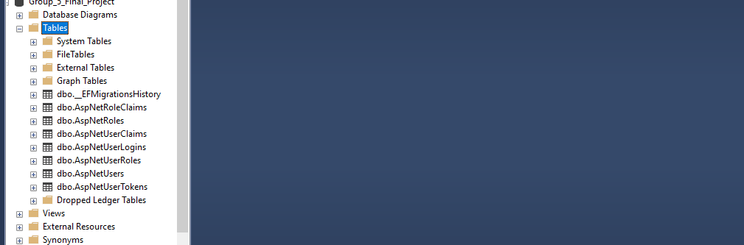
Output 4

Slide 10
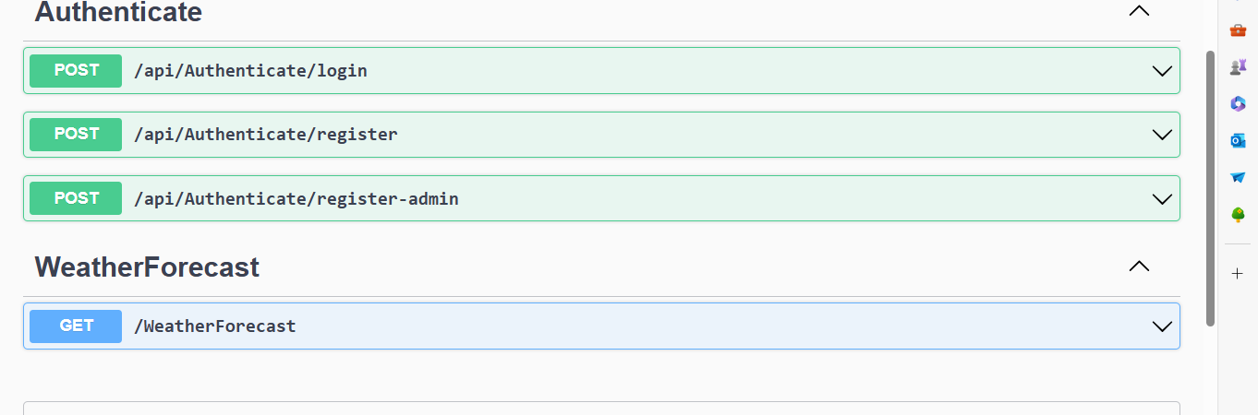
Registration link for each UserRole

Slide 11
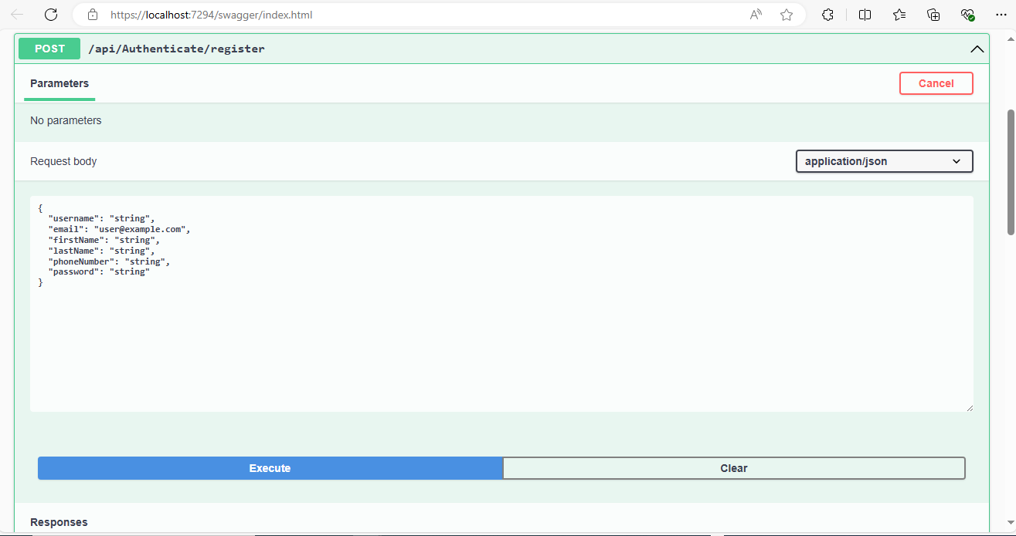

Slide 12
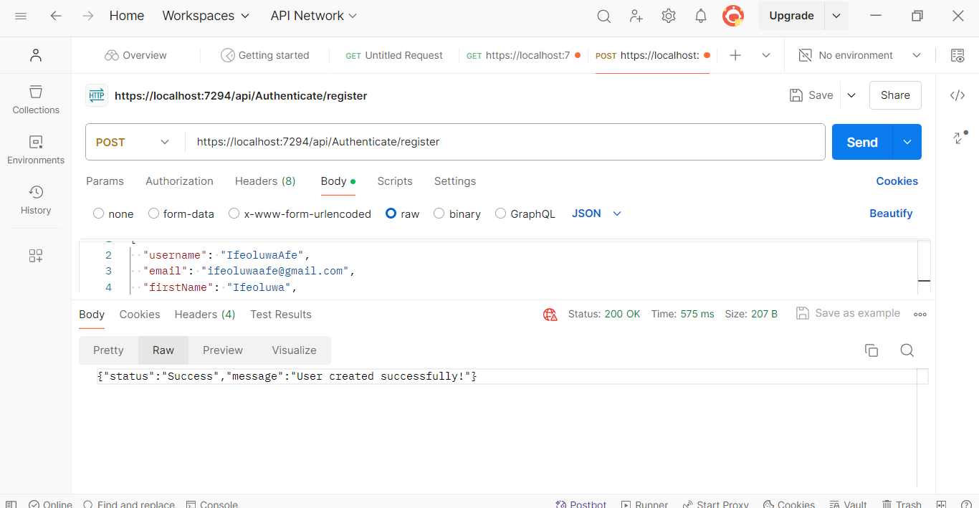

Slide 13
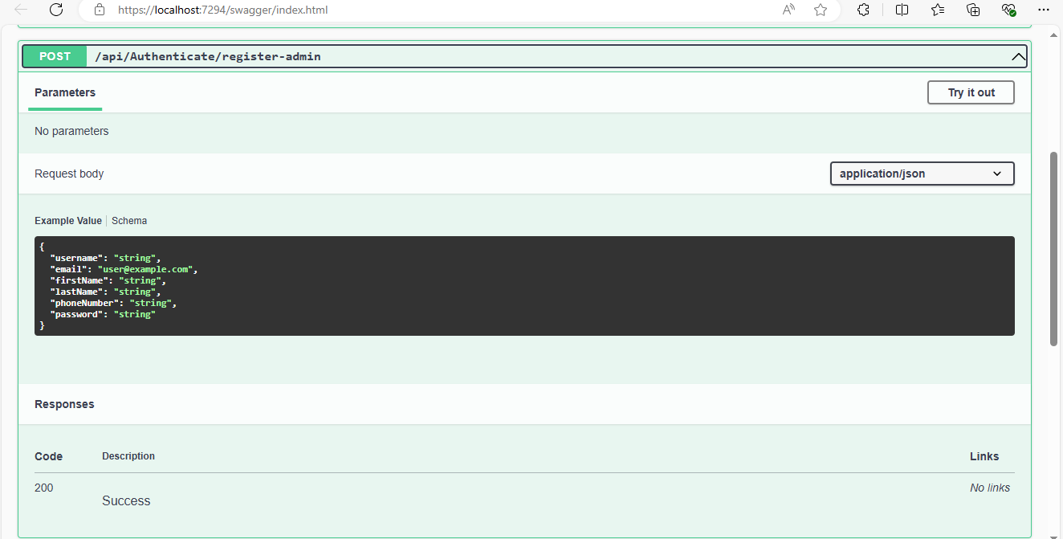

Slide 14
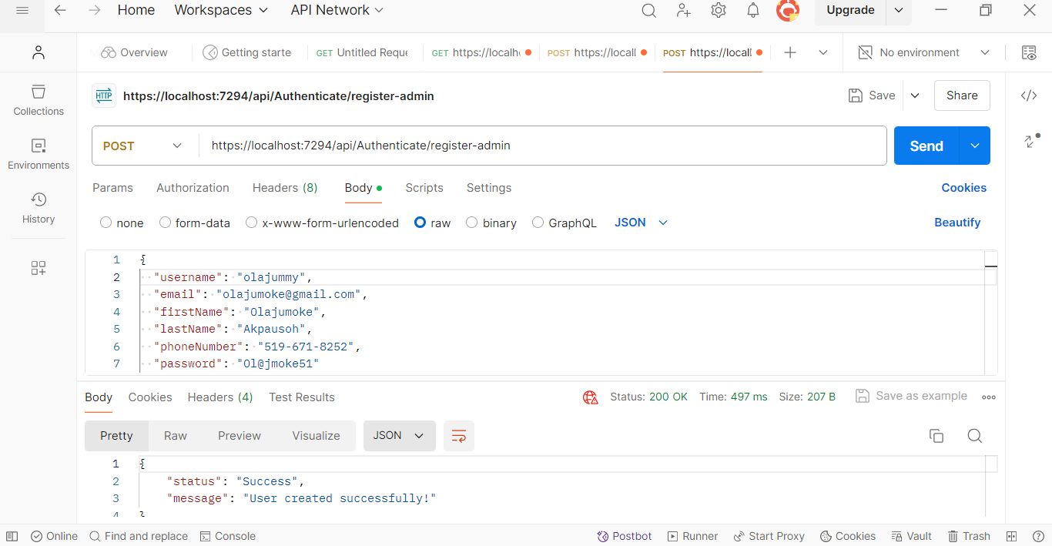

Slide 15
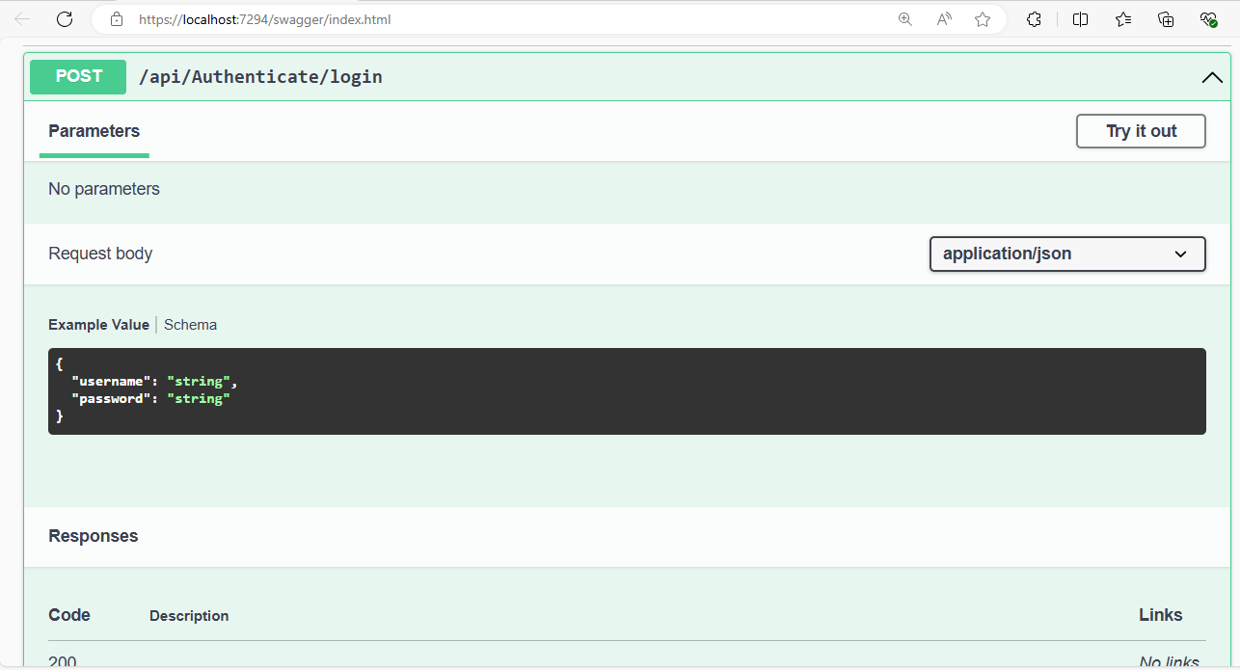

Slide 16
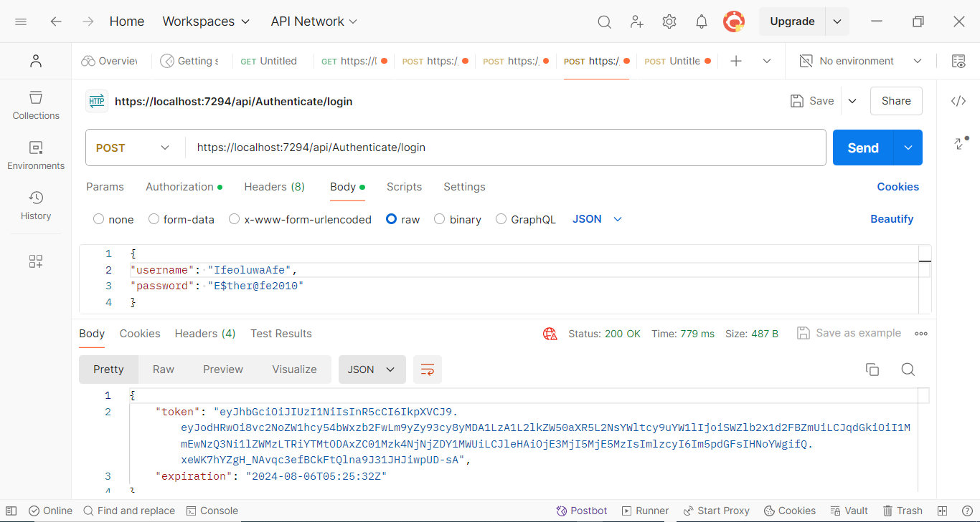

Slide 17
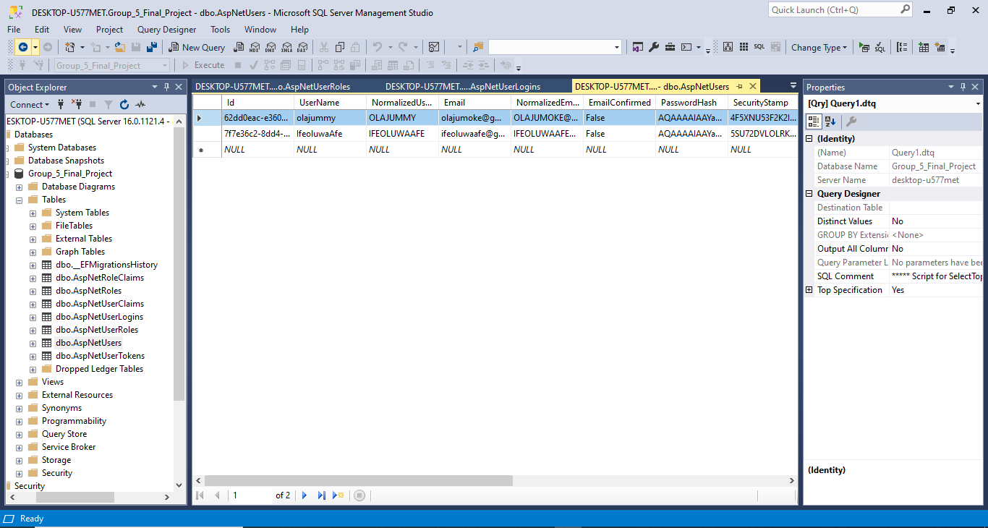

Slide 18
Thank You

